Slide 1

IBM SkillsBuild for Adult Learners - Data Analytics
Data Analytics Internship Program 2024 Final Project Presentation
Project Name : Air Quality Analysis
Unique ID: IBM060Project Name : Air Quality Analysis
Unique ID: IBM0602 Team Name : Data Titans
College Name : Career Point University
Team Name : Data Titans
College Name : Career Point University

Slide 2



Team Members
Kashish Bodhwani
Vishabh Tiwari
Ruchi Singh
Disha Nandwana

Slide 3
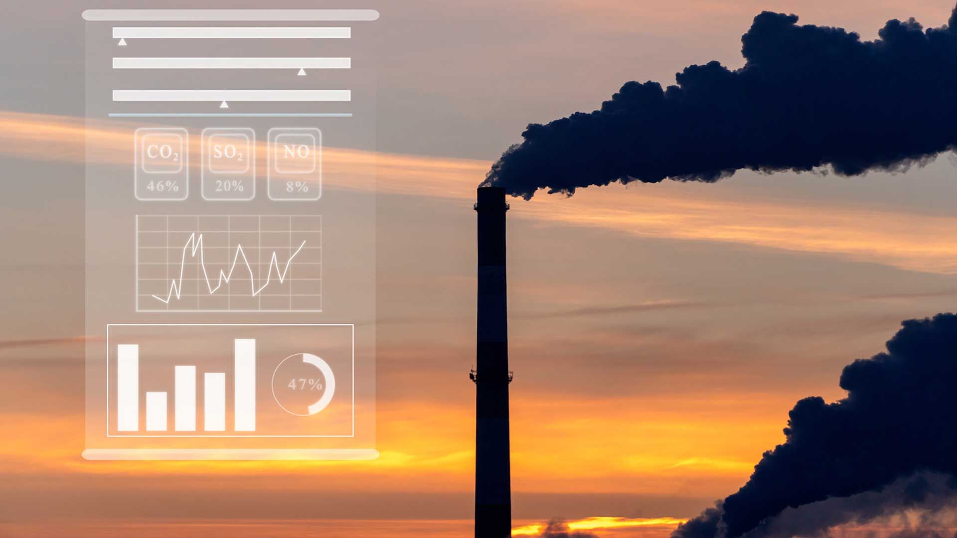
Introduction
Overview of the Project
The Air Quality Analysis project aims to monitor, analyze, and predict air quality levels in various regions using data science and machine learning techniques. The goal is to provide actionable insights that can help mitigate pollution and improve public health. Air Quality Analysis project stands as a pivotal initiative at the intersection of environmental science, technology, and public health, striving to create a cleaner, healthier future through informed decision-making and actionable insights.
Objective
Assess Current Air Quality: Measure concentrations of pollutants like PM2.5, NO2, and O3.
Identify Pollution Sources: Determine primary sources such as vehicles and industries.
Analysis Temporal Trends: Study daily, seasonal, and annual air quality variations.
Health Impact Assessment: Correlate pollution data with health records for impact Forecasting and Predictive Analysis: Develop models to predict future air quality.
Sustainability and Long-term Planning: Integrate air quality with broader environmental strategies.

Slide 4
Problem Identification
Problem Statement
Leveraging Data Science and Machine Learning: Utilize advanced data science and machine learning techniques to monitor, analyze, and predict air quality levels, recognizing their profound impacts on public health and the environment.
Integration of Data: Combine historical and real-time air quality and meteorological data to ensure comprehensive and accurate analysis
Data Cleaning and Preprocessing: Implement rigorous data cleaning and preprocessing steps to maintain data accuracy and reliability.
Exploratory Data Analysis: Use exploratory data analysis (EDA) and statistical methods to identify patterns and relationships within the data, providing actionable insights.
Machine Learning Forecasting: Develop machine learning models to forecast air quality, enabling proactive measures to mitigate health issues and environmental damage.

Slide 5
Problem Identification
Significance of the Problem
Public Health:Poor air quality is linked to numerous health issues, including respiratory and cardiovascular diseases, allergies, and premature deaths. Understanding and mitigating air pollution can significantly improve public health outcomes.
Environmental Impact:Air pollution contributes to environmental degradation, including acid rain, reduced visibility, and harm to wildlife and ecosystems. Analyzing air quality helps in preserving natural habitats and biodiversity.
Climate Change:Air pollutants, such as black carbon and methane, contribute to global warming. Addressing air quality issues is therefore integral to combating climate change and achieving sustainability goals.
Relevant SDGs
SDG 3: Good Health and Well-being: Improving air quality directly contributes to better respiratory and cardiovascular health, reducing the incidence of diseases and enhancing overall well-being.
SDG 11: Sustainable Cities and Communities: Monitoring and improving air quality helps create sustainable urban environments, making cities safer and more resilient to pollution-related challenges.
SDG 13: Climate Action: By analyzing and mitigating air pollution, the project supports efforts to combat climate change and reduce greenhouse gas emissions.

Slide 6
Data Collection
Sources of Data
Kaggle: Various air quality datasets, such as "Air Quality Data in India" and "Air Quality in Major Cities."
The dataset used can be downloaded Here from the 2013 to 2018.
Data Description
The Air Quality Index (AQI) is used for reporting daily air quality. It tells you how clean or polluted your air is, and what associated health effects might be a concern for you. The AQI focuses on health effects you may experience within a few hours or days after breathing polluted air.
Data Collection Methods
Fixed Air Quality Monitoring Stations:
Mobile Monitoring Units:
Crowdsourced Data Collection:

Slide 7
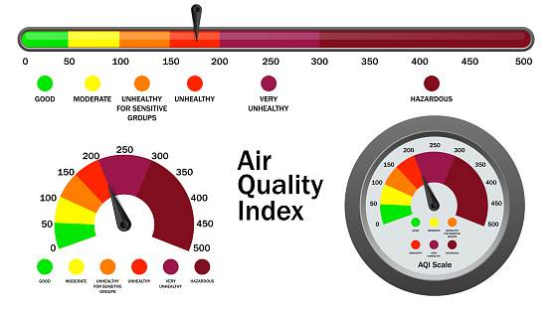
PURPOSE OF THE PROJECT
Our Goal is to provide complete analysis and detection from pre defined dataset.

Slide 8
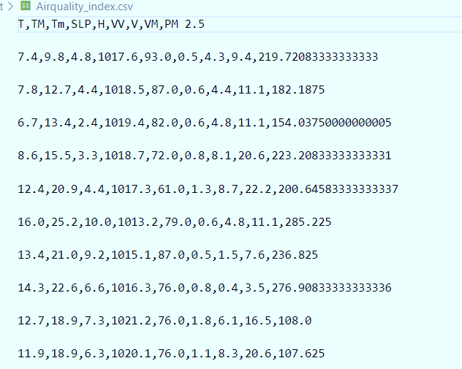
SOURCES OF DATA USED
Data Source – Data is taken from Kaggle. There are several attributes in the data set on the basis of which we are predicting , analyzing , visualizing and detection of air quality analysis.
Link- Air Quality Index (kaggle.com)

Slide 9
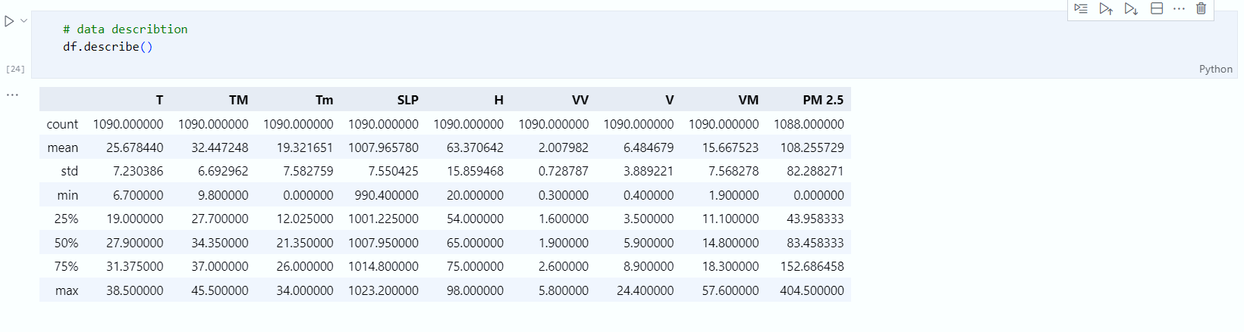
DATA BEFORE CLEANING

Slide 10
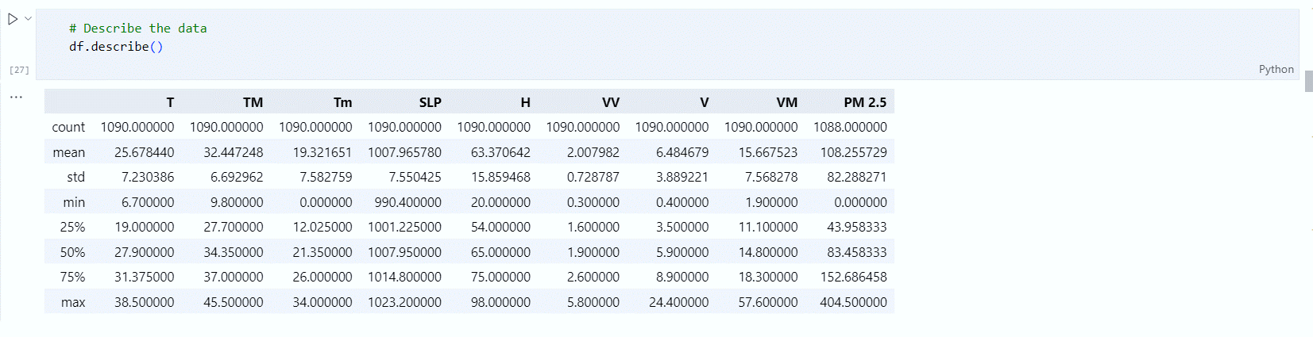
DATA AFTER CLEANING

Slide 11
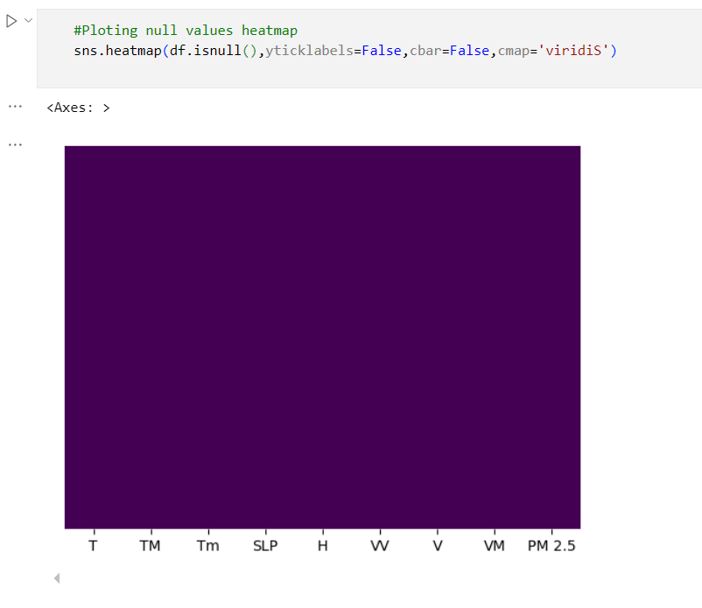
HEAT MAP
DATA VISUALIZATION

Slide 12
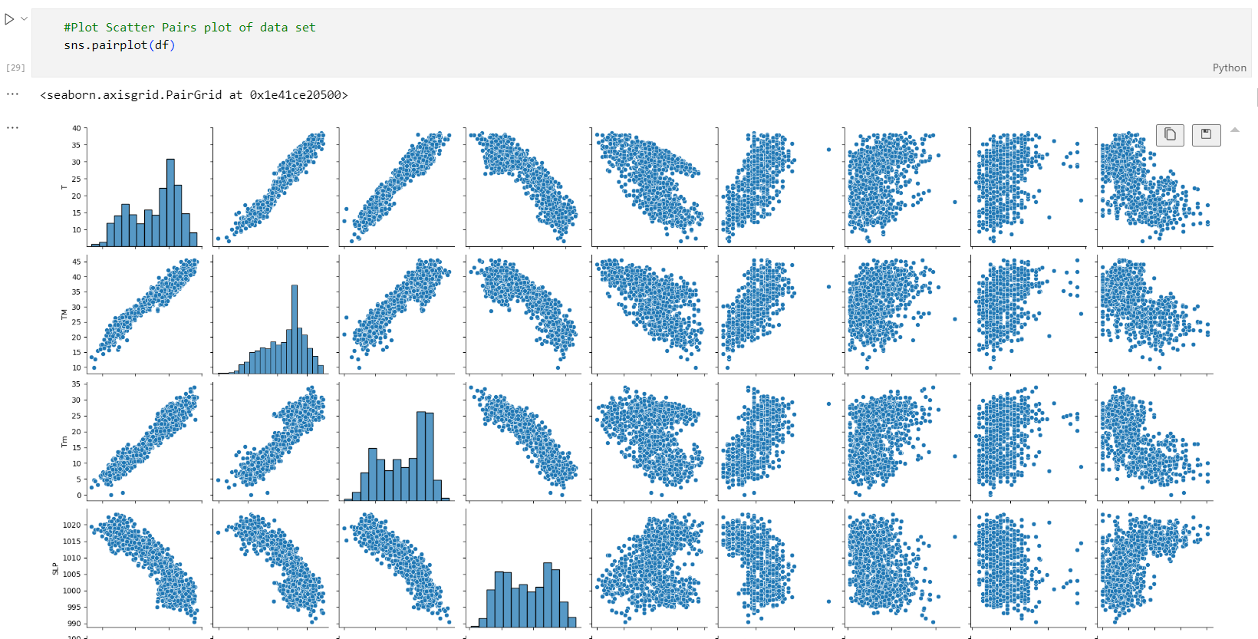
PAIR-PLOT OF THE FEATURES INCLUDED IN THE DATASET

Slide 13
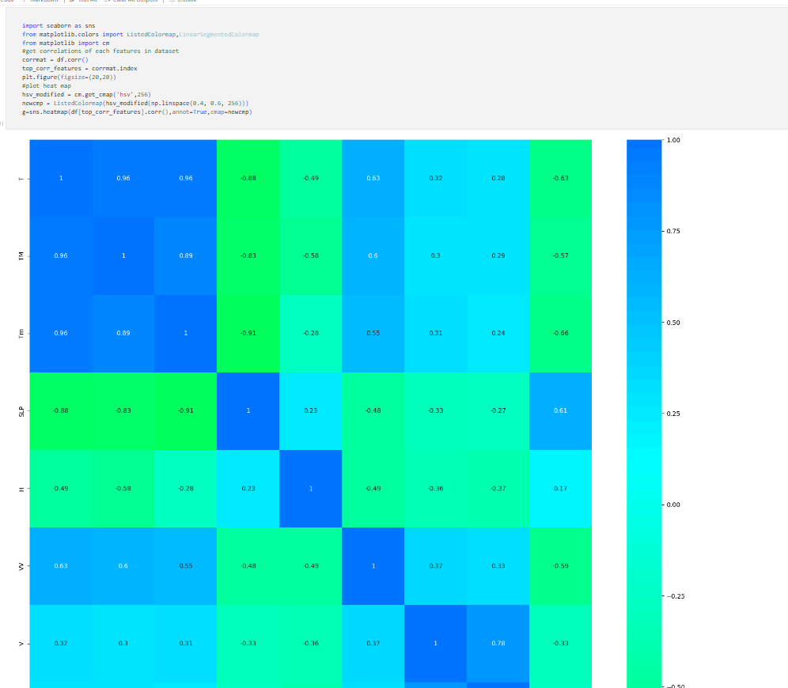
FIG – 3:
Heatmap – Correlation of each feature in the dataset.

Slide 14
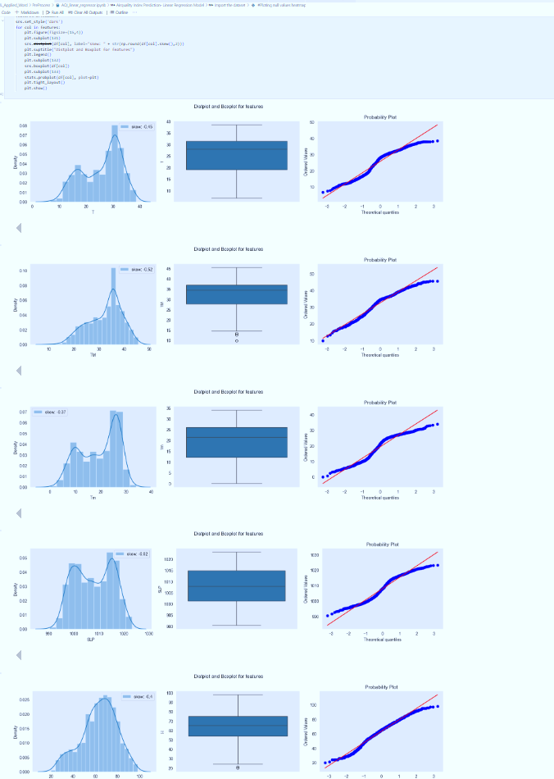
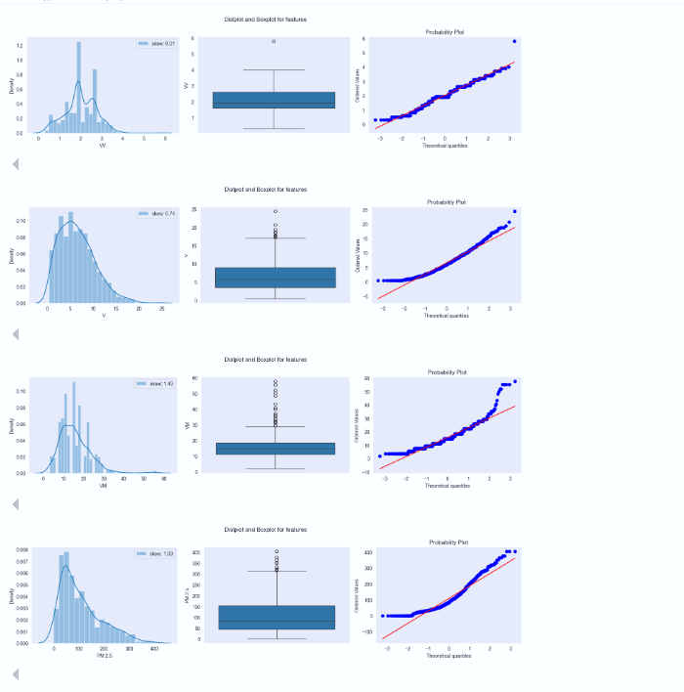
DISPLOTS AND BOXPLOTS FOR THE FEATURES OF THE DATA SET

Slide 15
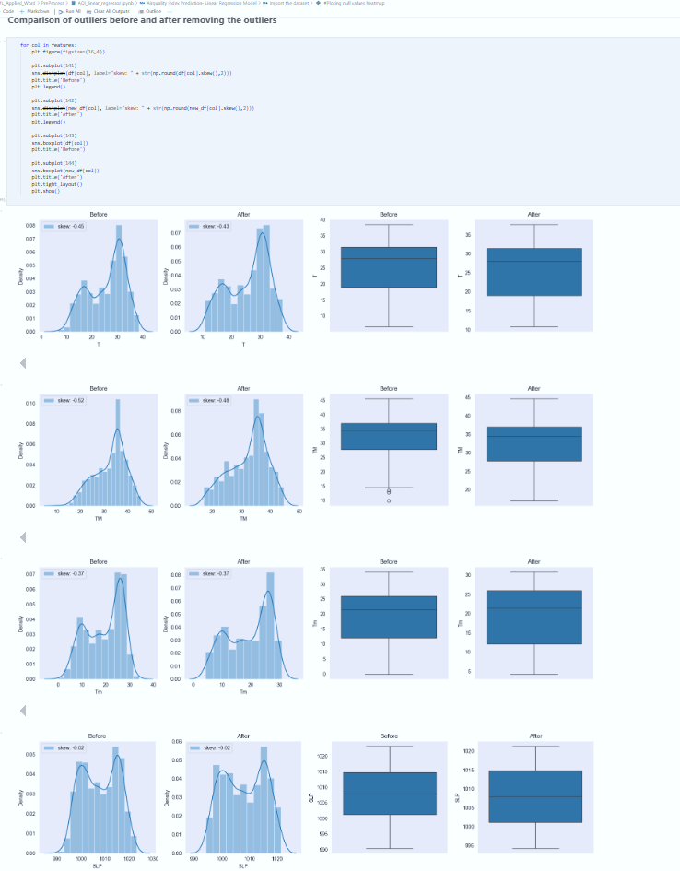
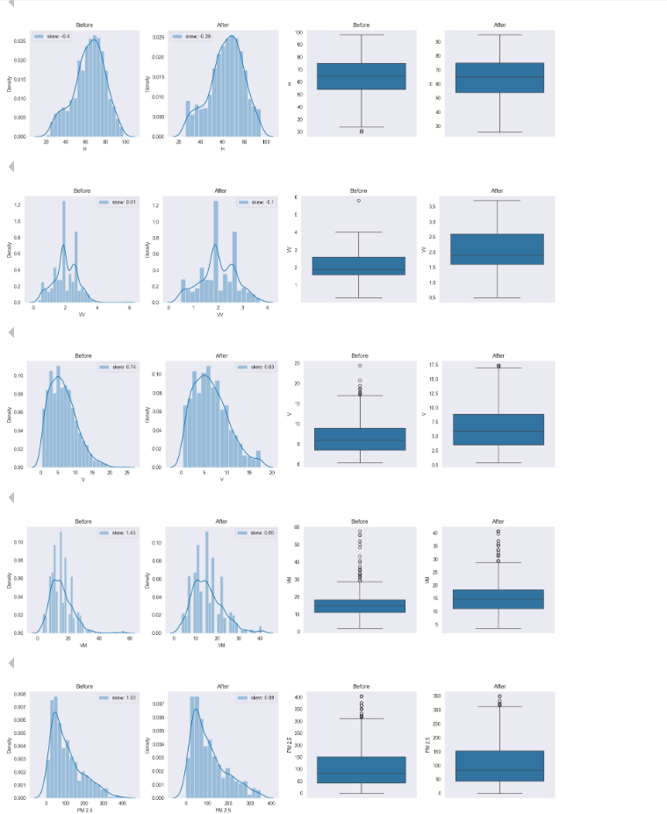
BEFORE AND AFTER REMOVING OUTLINERS

Slide 16
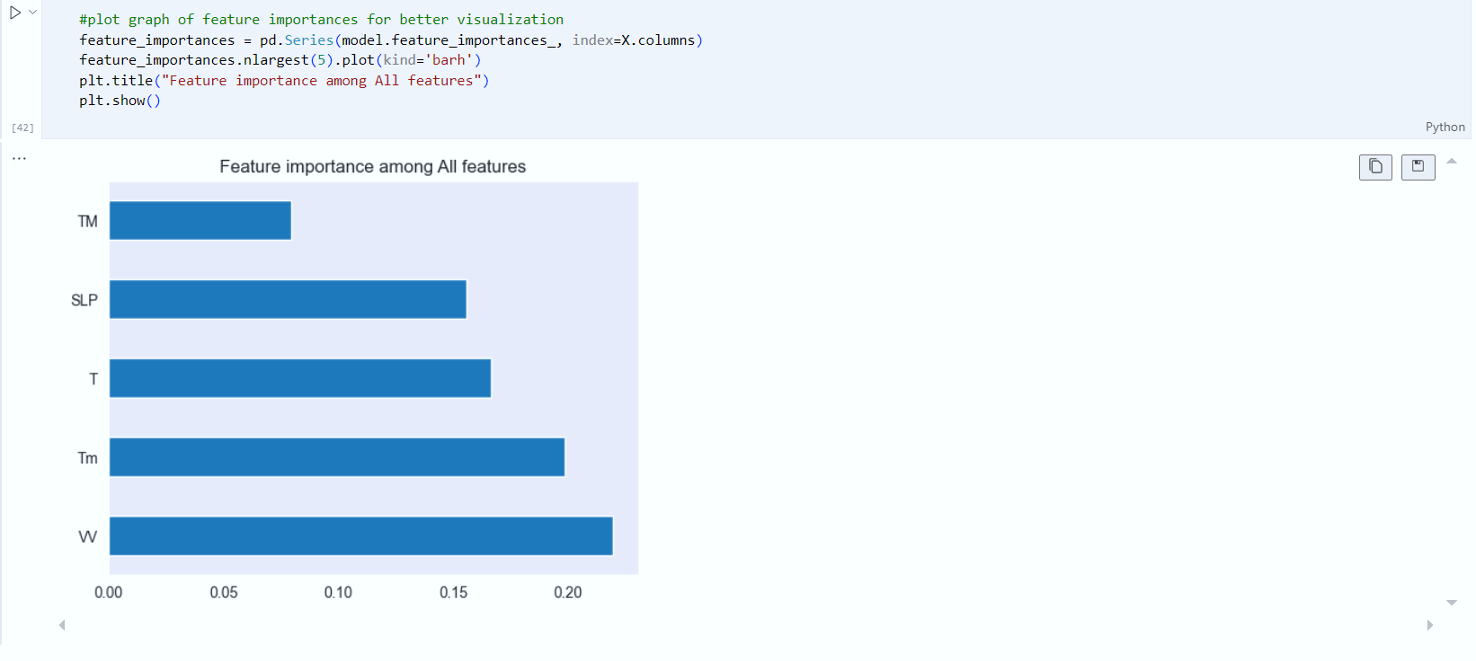
FEATURE IMPORTANCE AMONG ALL FEATURES

Slide 17
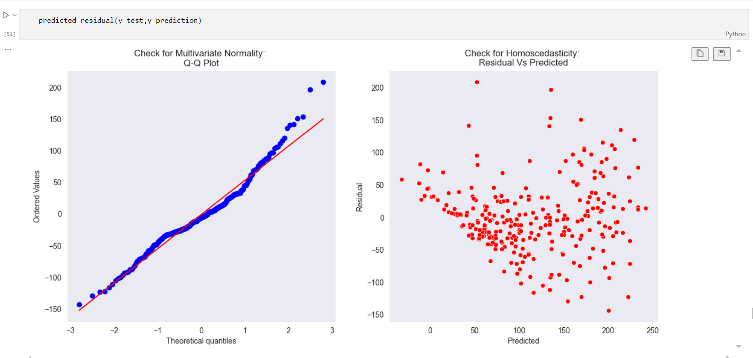
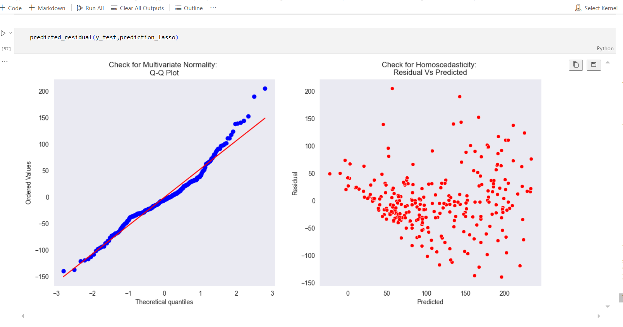
OUTPUTS OF MACHINE LEARNING ALGORITHMS
– LINEAR REGRESSION
RIDGE AND LASSO REGRESSION

Slide 18
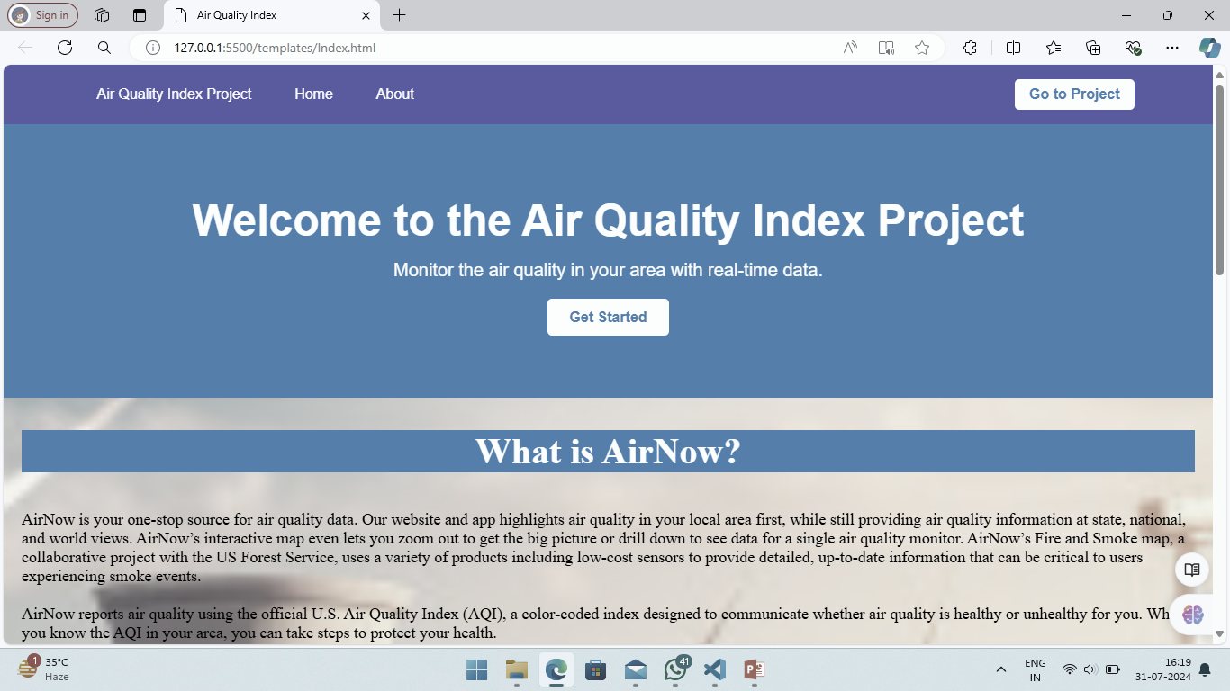
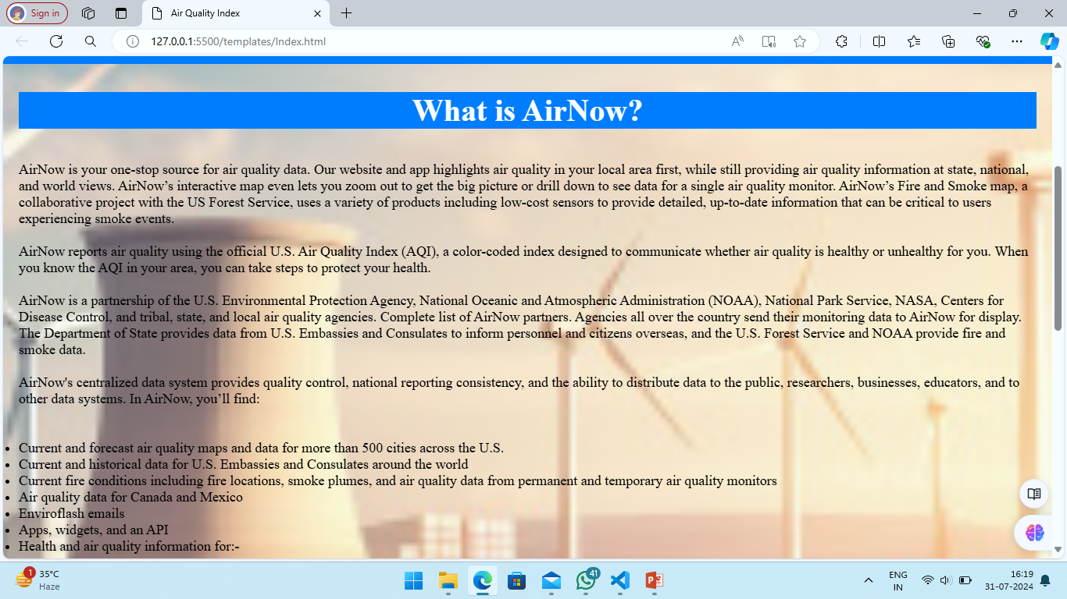
SOME GLIMPSES OF OUR PROJECT
Fig. -1
Fig. - 2

Slide 19
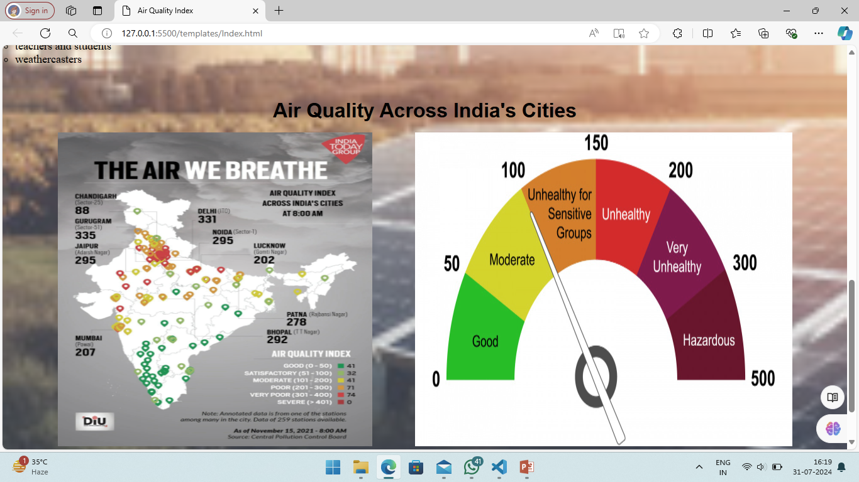
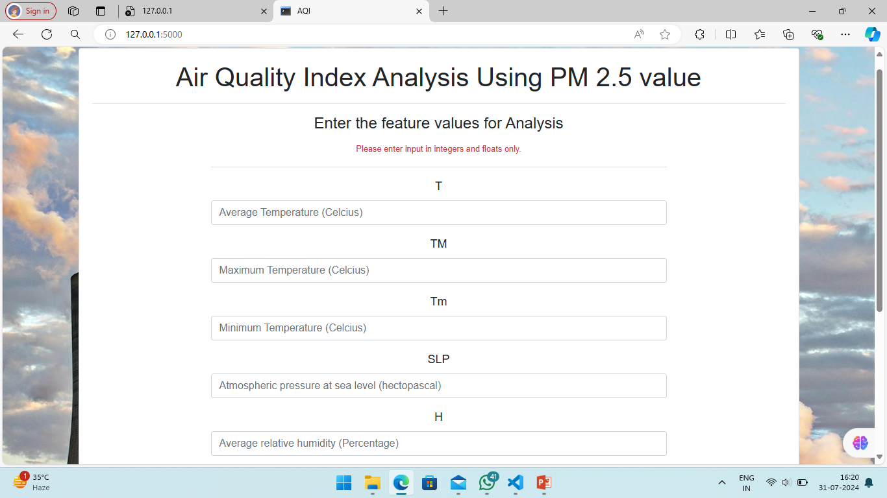
MORE GLIMPSES OF PROJECT

Slide 20
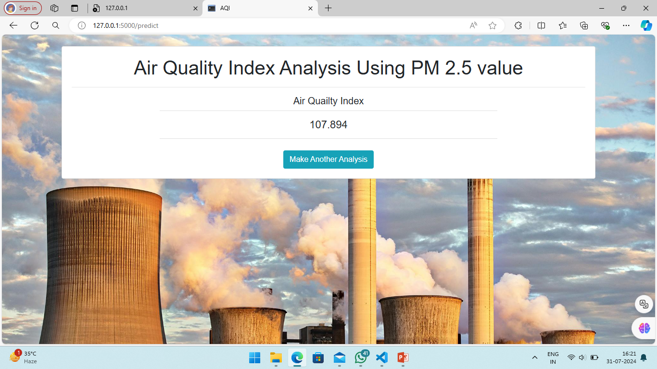

Slide 21




